Slide 1
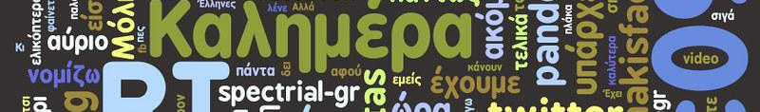
VERB USAGE
ACROSS
RECENT CENTURIES
04.08.2024
LING 240 FINAL PRESENTATION
Benjamin Andreasen

Slide 2
Hypothesis
Modern books use fewer irregular verbs than older books.

Slide 3
Tools and Attributions
Project Gutenberg
Google Books
Open Library
Inferential Statistics Toolkit
Cambridge Dictionary
Google Colab

Slide 4
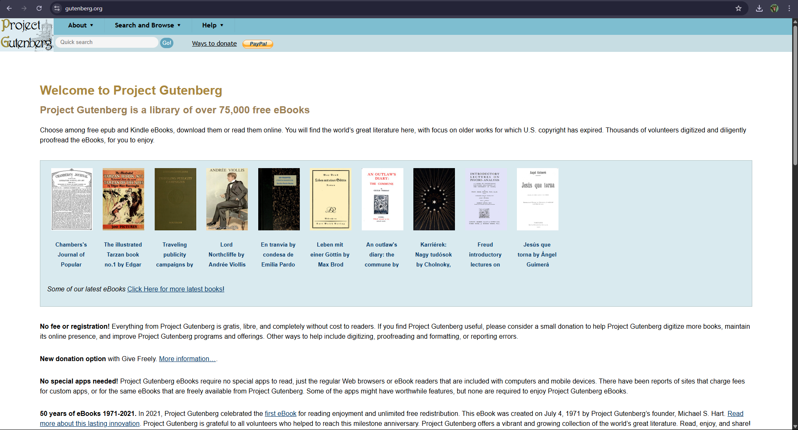

Slide 5
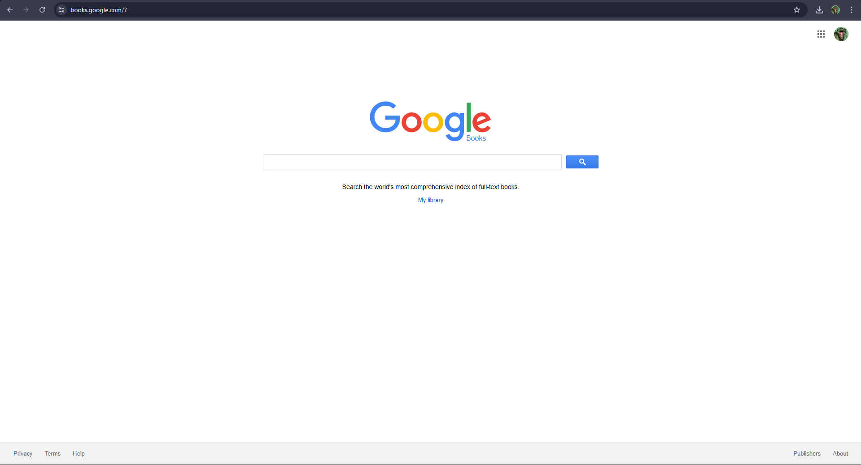

Slide 6
Methods
See colab for methods and results

